Slide 1
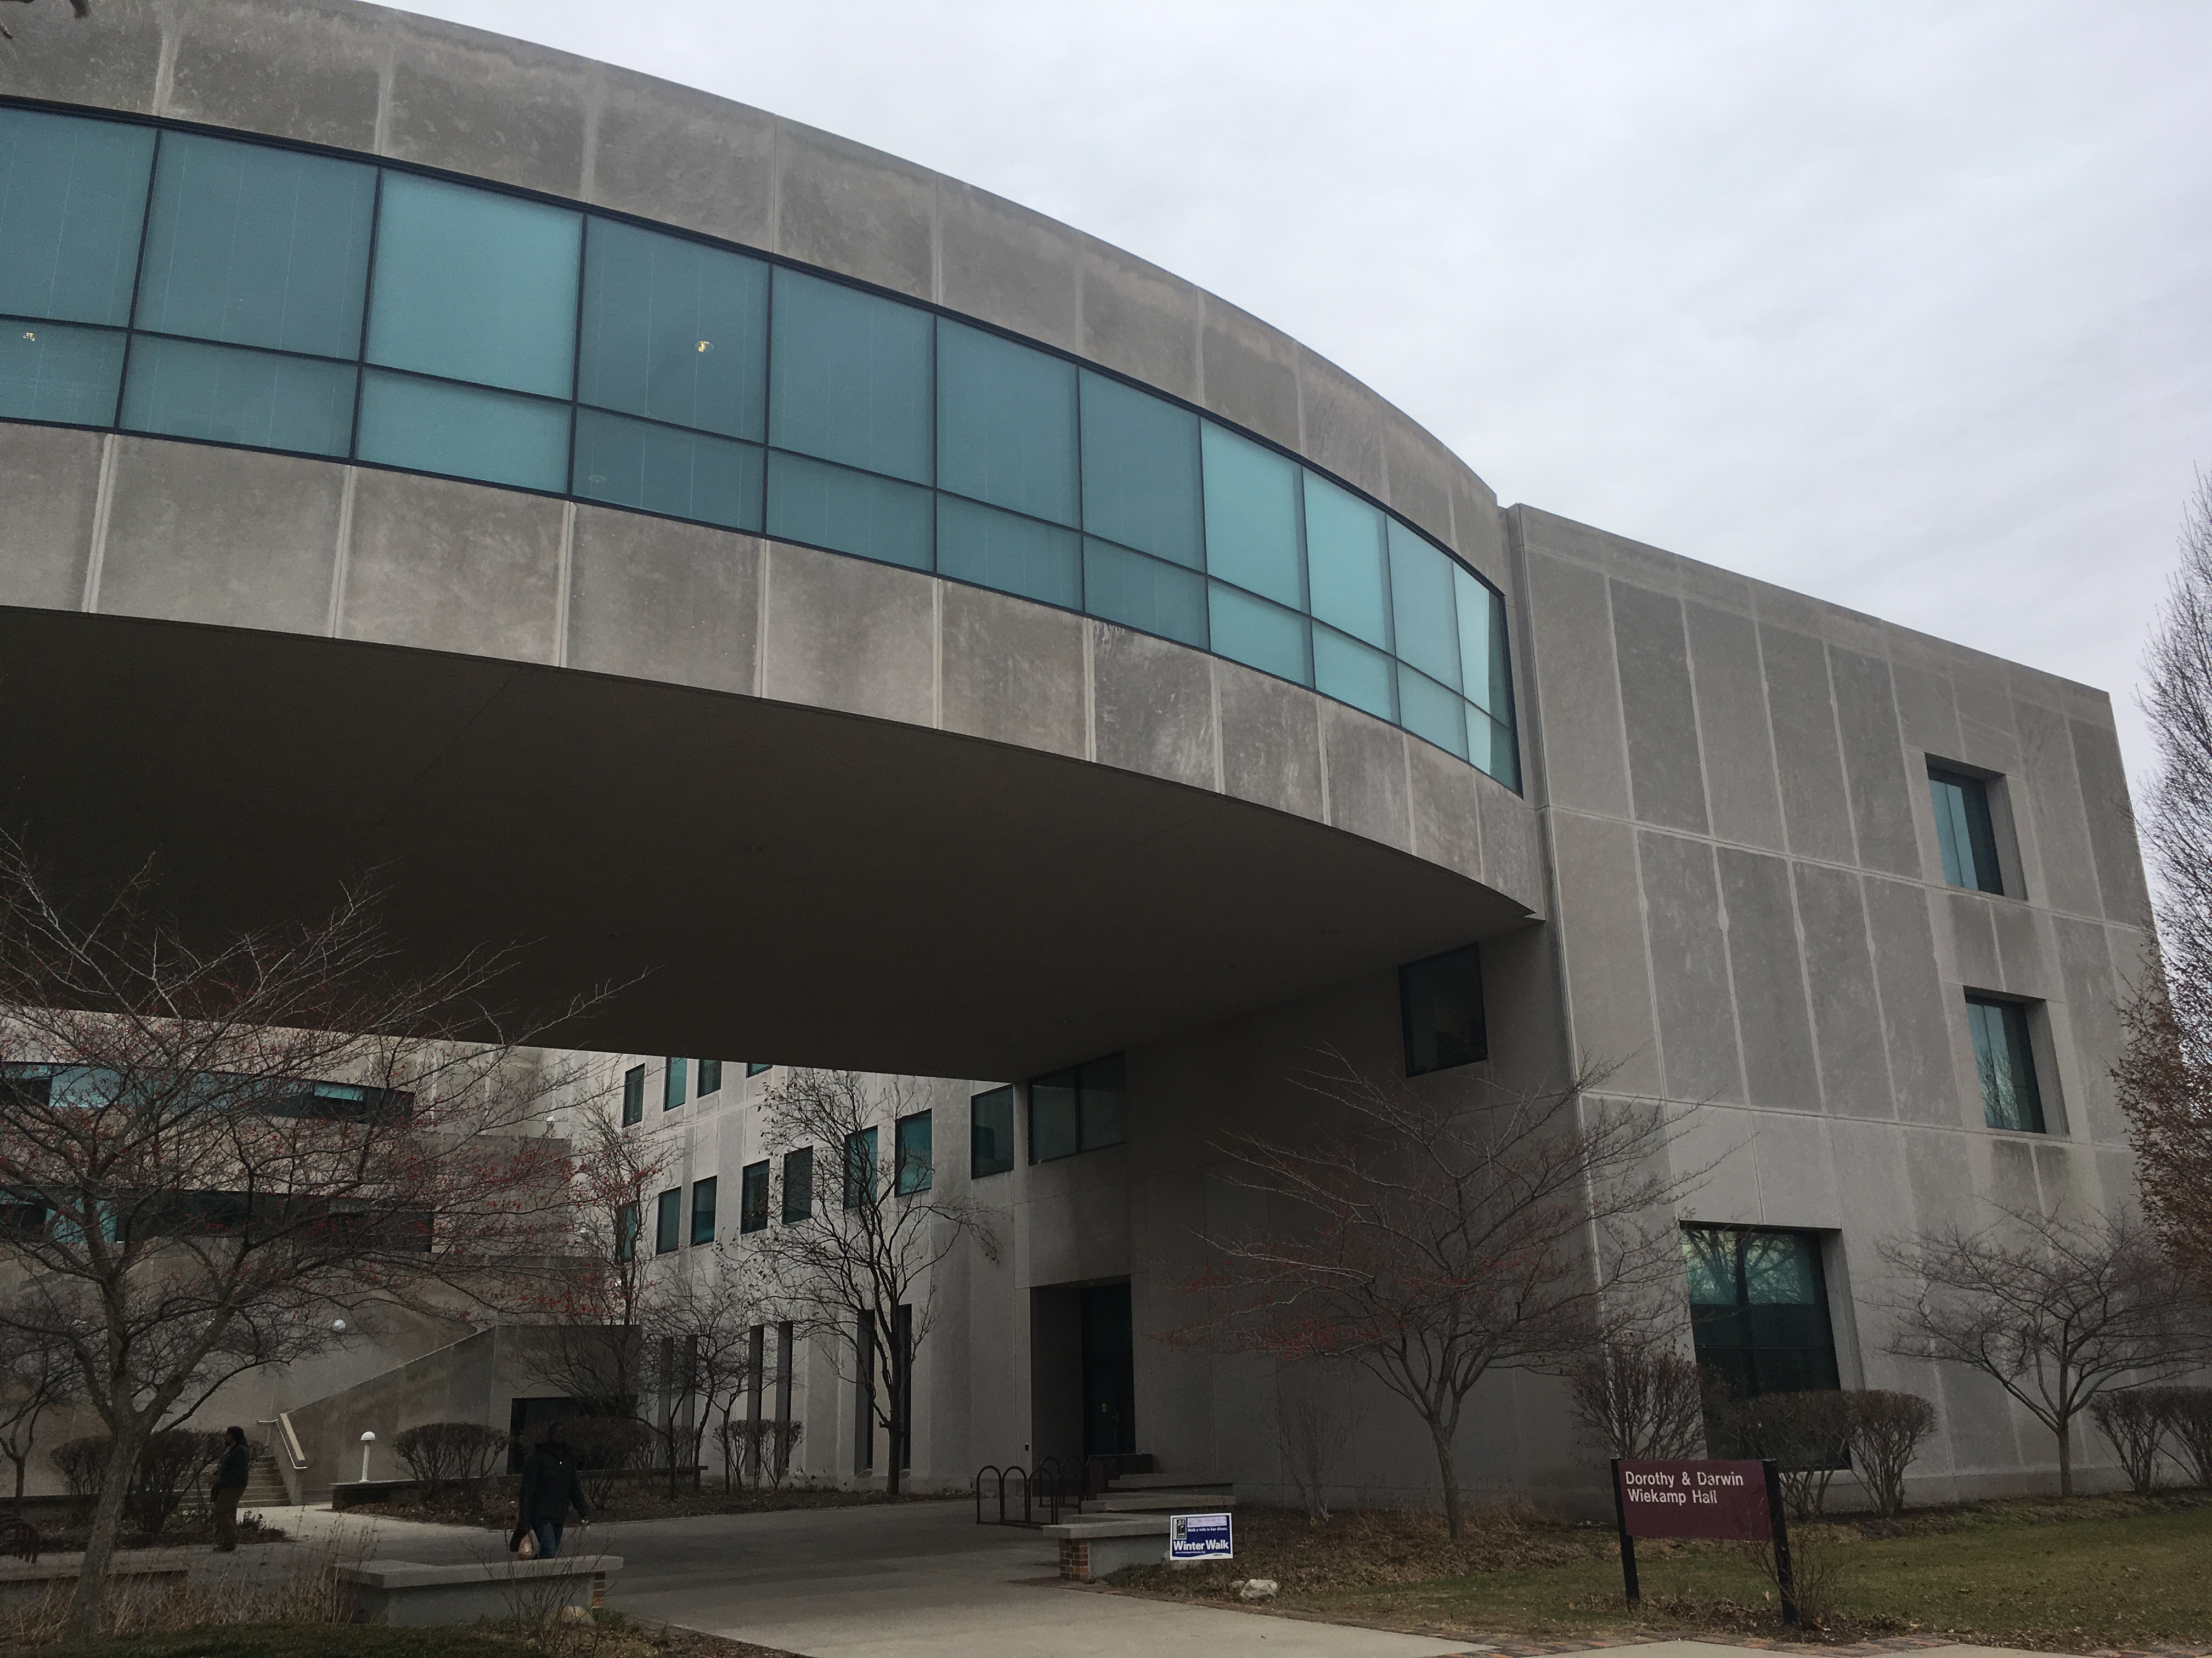
Kudos February 2017

Slide 2

History
Micheline Nilsen's “Architecture in Nineteenth-century Photographs: Essays on Reading a Collection” has just been reissued in paperback by Routledge.

Slide 3
Psychology
Carolyn Schult received a UCET/FACET Faculty Development Award for the Developmental Science Teaching Institute at the Society of Research in Child Development.

Slide 4
English
Rob Russell has two pieces coming out: "Lord of the Lake," will be published in Gravel Literary Magazine in February, and is a finalist in the Parks and Points Fall 2016 Essay Contest. His story, “She Lit a Fire,” will be in the next issue of Passages North and was the runner-up in their 2016 Waasnode Fiction Prize.
McKenzie Tozan’s “Trump poem” from last month is now featured on the website of Speak Michiana.

Slide 5
English
MA student James Elrod was just accepted with full funding into the University of Michigan’s Screen Arts and Cultures PhD program
Rebecca Gerdes, former IUSB English student, just received a tenure-track job as the First Year Writing Director at Columbus State University in Georgia.

Slide 6
Math
Peter Connor published a paper: “A note on special polynomials and minimal surfaces” in the Houston Journal of Mathematics

Slide 7
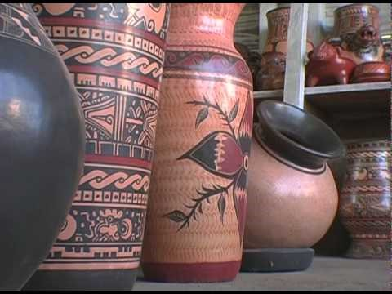
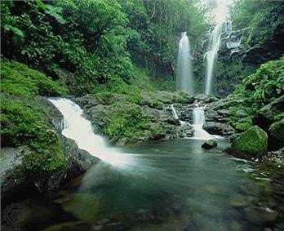
World Language Studies
Tammy Morgan, in cooperation with the Center for a Sustainable Future and the Office of International Programs, has developed a new study abroad trip in Nicoya, Costa Rica. It includes an intensive Spanish language course coupled with T190/T390 courses about healthy lifeways, sustainability, and ecotourism in Central America, as well as an option to learn basic Spanish for Medical Personnel.

Slide 8
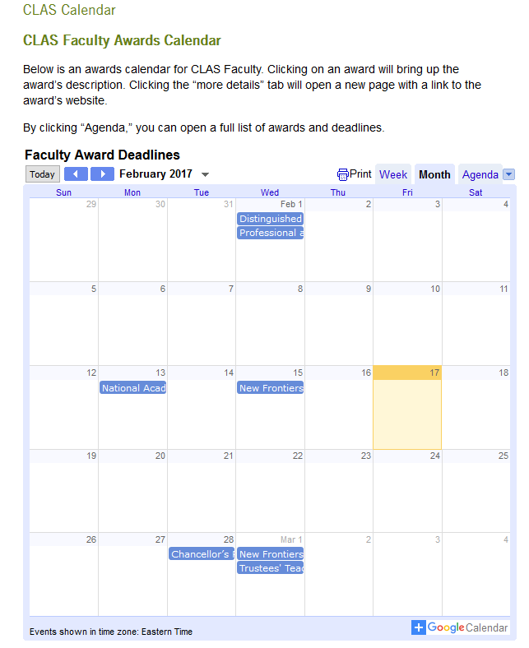
Faculty and Staff Affairs Committee
A CLAS awards calendar is now available!
https://www.iusb.edu/clas/facstaff/Calendar .php
The entire committee (Tom Clark, Louise Collins, Letecia McKinney, Nicole Mason, Neovi Karakatsanis, Micheline Nilsen, and John Pankow) worked on this project. The committee would also like to acknowledge Nick Wort, Lee Kahan, and Neovi Karakatsanis for their help in creating the calendar.

